Slide 1
Listener State Transition Estimation
Intro to data science capstone project
Dai tran

Slide 2
Background and Objective
The client, Pandora Media, has 20 million daily active users with the majority being non-paying ad supported listeners and a minority being paying subscribers. The subscription service is of growing importance to the company and given the limited number of ads the company can allocate to promote the subscription service, there is a need for segmenting the listener base to those who are more likely to upgrade for targeted ads.
Proposed solution: Leverage known user behavior, demographics, and listening hours to predict likelihood of a listener to switch from non-paying to paying state for Pandora for targeting system.

Slide 3
Process
Understand the lay of the land
Establish what should be considered the desired listener state change
Brainstorm features that may help predict listener state change
Consolidate data tables for cleaning, munging, and analysis
Choose appropriate ML algorithm for desired objective
Create train and test data sets
Train the models and validate on test set
Score the model on the test set
Iterate as needed
Notes:
Currently there are ~20MM daily active listeners of which only ~10k trial / subscription start.
Show SQL queries for data collection and management / wrangling

Slide 4
Complications & Potential Solutions
Large base of users who are non-paying relative to paying
Baseline model with the assumption that no listener changes state would be correct 552583/552613 (99%) of the time
Leverage unsupervised methods to identify clusters of higher density paying subscribers as a feature for supervised model
Tweak success metric from accuracy to any gain above baseline

Slide 5
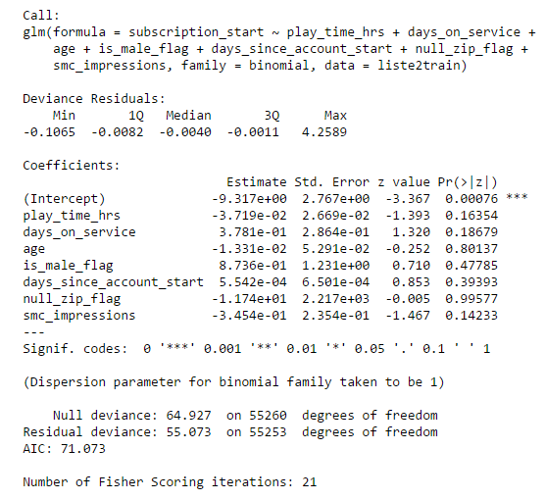

Current feature set shows no features having significance; the performance at the ROC-curve-suggested threshold is in line with the baseline model
Notes:
Multiple R-squared and adjusted R-squared is very close to 0 which means the model is not that good at predicting listener state changes
While the linear regression model showed that listening hours and ad impressions seen as significant features, the performance was in line with the logistic regression model. I went with the logit model because the dependent variable is not continuous but rather categorical (yes or no).

Slide 6
Next steps
Extend feature set
Perform unsupervised learning approach to reduce noise of the data
Use identified cluster as a feature for supervised learning approach
Consider imbalanced sampling to boost occurrence of listener transition state change
Expand time range used for listener state change to occur

Slide 7
Thank you
Special thanks to you, Melvin, for all the help you have given me and all the knowledge you have bestowed upon me over the past 3 months. It has been a great experience and I feel much better equipped to move forward with this project as well as future projects.

